Slide 1
Existentialism Thesis Defense
Here is where your presentation begins

Slide 2
Contents of this template
You can delete this slide when you’re done editing the presentation
Fonts | To view this template correctly in PowerPoint, download and install the fonts we used
Used and alternative resources | An assortment of graphic resources that are suitable for use in this presentation
Thanks slide | You must keep it so that proper credits for our design are given
Colors | All the colors used in this presentation
Icons and infographic resources | These can be used in the template, and their size and color can be edited
Editable presentation theme | You can edit the master slides easily. For more info, click here
For more info: SLIDESGO | BLOG | FAQs
You can visit our sister projects: FREEPIK | FLATICON | STORYSET | WEPIK | VIDEVO

Slide 3
Table of contents
01
02
03
The philosophy of existence
Existentialist concepts
The essence of existentialism
You can describe the topic of the section here
You can describe the topic of the section here
You can describe the topic of the section here

Slide 4
01
The philosophy
of existence
You can describe the topic of the section here

Slide 5
Exploring the philosophy of existence
What about Mercury?
Mercury is the closest planet to the Sun and the smallest one in the Solar System—it’s only a bit larger than the Moon. The planet’s name has nothing to do with the liquid metal
What about Venus?
Venus has a beautiful name and is the second planet from the Sun. It’s terribly hot—even hotter than Mercury—and its atmosphere is extremely poisonous
What about Jupiter?
Jupiter is a gas giant and the biggest planet in the Solar System. It's the fourth-brightest object in the night sky. It was named after the Roman god of the skies and lightning

Slide 6
—Someone Famous
“This is a quote. Words full of wisdom that someone important said and can make the reader get inspired”

Slide 7
98,300,000
Big numbers catch your audience’s attention

Slide 8
9h 55m 23s
333,000
386,000 km
Jupiter's rotation period
The Sun’s mass compared to Earth’s
Distance between Earth and the Moon

Slide 9
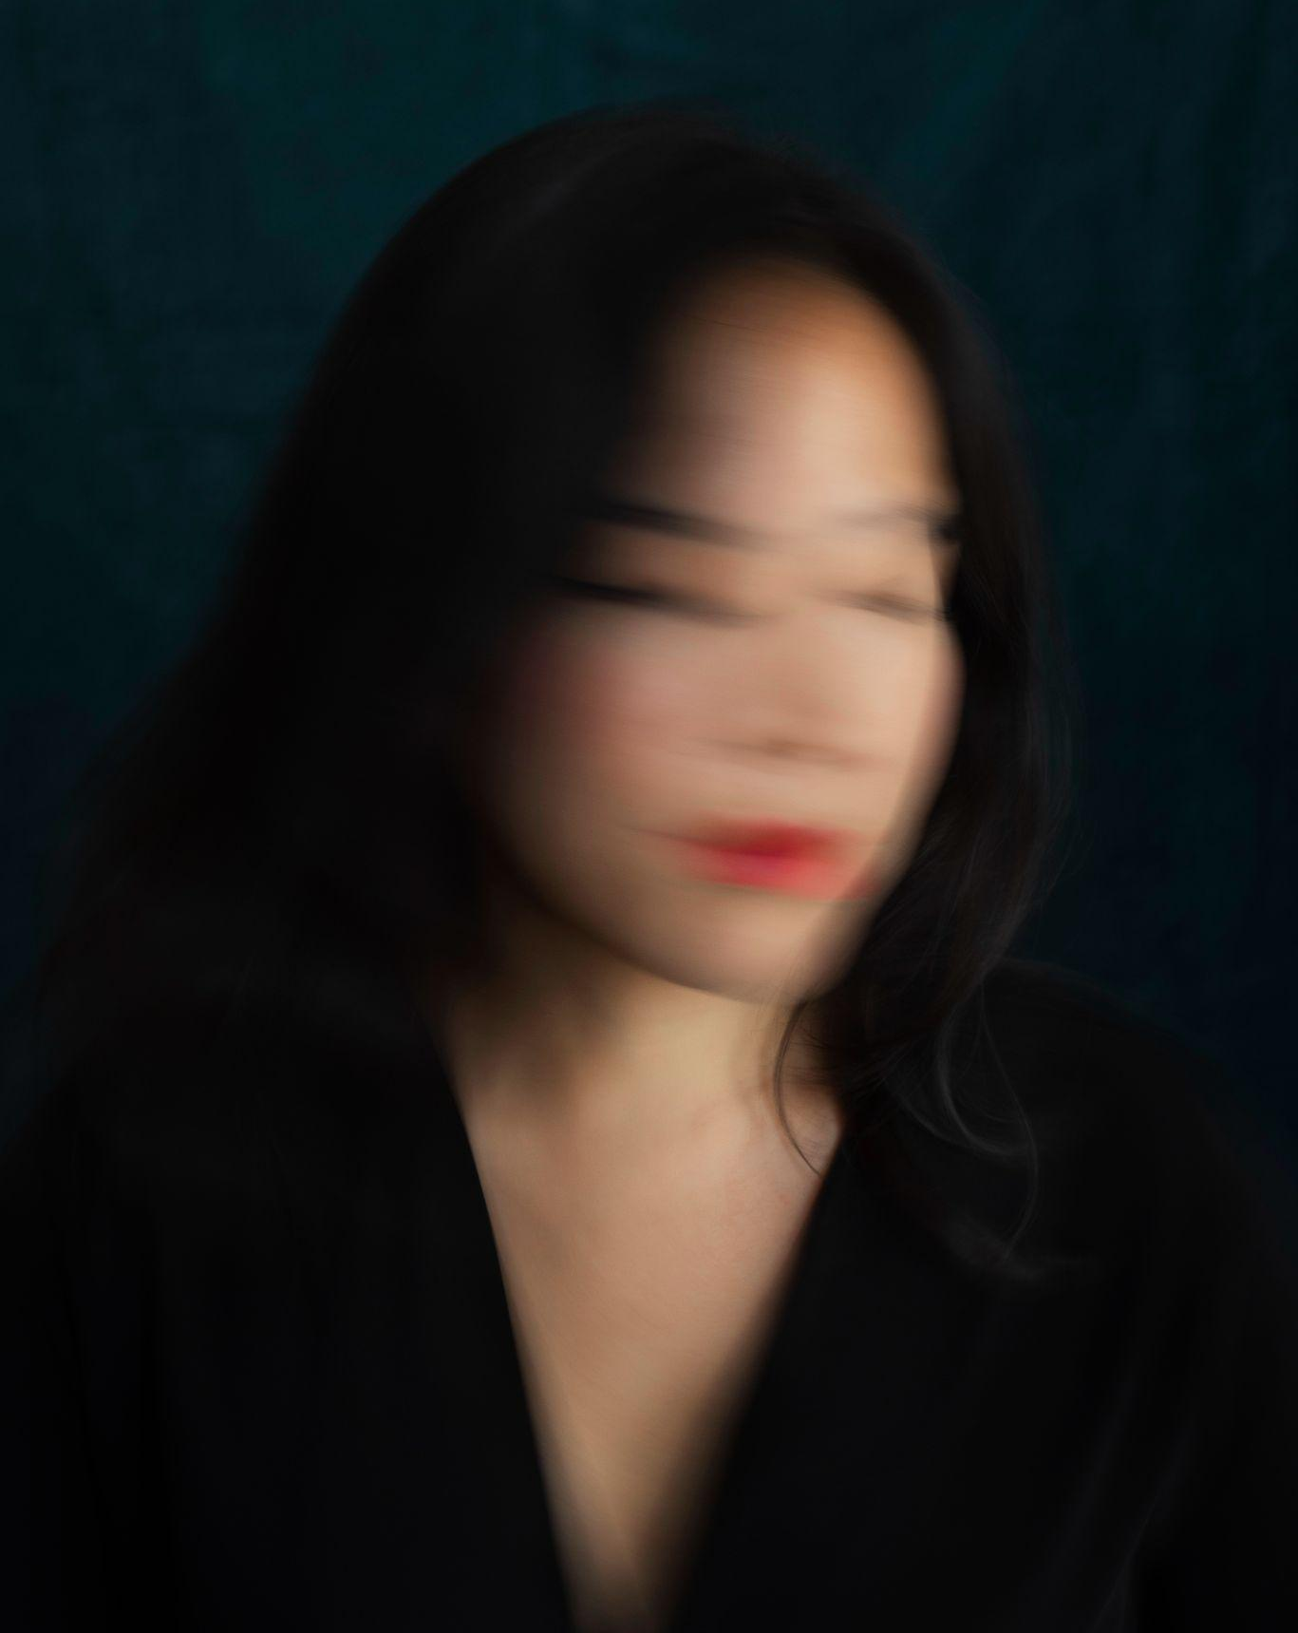
A picture
Always reinforces
the concept
Images reveal large amounts of data, so remember: use an image instead of a long
text. Your audience will appreciate it

Slide 10
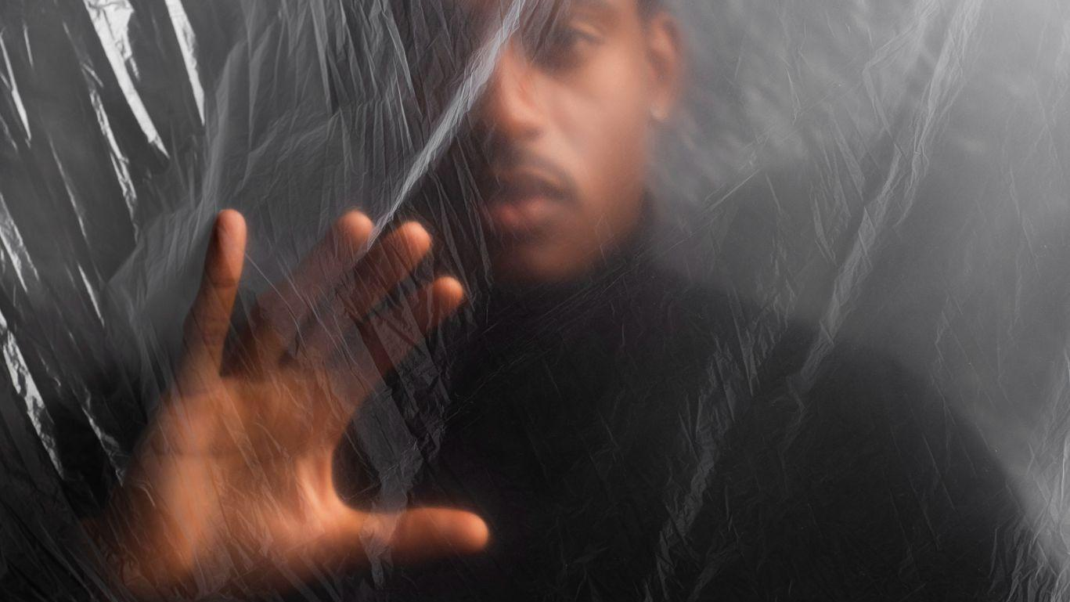
A picture is worth a thousand words

Slide 11
Awesome words

Slide 12
Unraveling the meaning of being
1
2
3
Current situation
Earth
Mars
Mercury
Jupiter is a gas giant and
the biggest planet in the
Solar System. It's the fourth brightest object in the night sky. It was named after the Roman god of the skies
and lightning
Earth is the third planet from the Sun and has life
Despite being red, Mars is actually a cold place
Mercury is the smallest planet in the Solar System
Problems

Slide 13
The essence of existentialism
1
Hypothesis 1
Mercury is the closest planet to the Sun and the smallest one in the Solar System—it’s only a bit larger than the Moon. The planet’s name has nothing to do with the liquid metal
2
Hypothesis 2
Venus has a beautiful name and is the second planet from the Sun. It’s terribly hot—even hotter than Mercury—and its atmosphere is extremely poisonous
3
Hypothesis 3
Jupiter is a gas giant and the biggest planet in the Solar System. It's the fourth-brightest object in the night sky. It was named after the Roman god of the skies and lightning

Slide 14
Unveiling existentialist concepts
Venus
Mars
Venus has a beautiful name and is the second planet from the Sun
Despite being red, Mars is actually a cold place. It’s full of iron oxide dust

Slide 15
Quest for meaning in a chaotic world
Mars
Venus
Neptune
Mars is actually a
very cold place
Venus has extremely high temperatures
Neptune is the farthest planet from the Sun
Mercury
Saturn
Jupiter
Mercury is the closest planet to the Sun
Saturn is a gas giant with several rings
Jupiter is the biggest planet of them all

Slide 16
Literature review
AUTHOR. (YEAR). Title of the publication. Publisher
Mercury is the closest planet to the Sun and the smallest one in the Solar System
AUTHOR. (YEAR). Title of the publication. Publisher
Mars is full of iron oxide dust, which gives the planet its reddish cast
AUTHOR. (YEAR). Title of the publication. Publisher
Jupiter is a gas giant and the biggest planet in the Solar System
AUTHOR. (YEAR). Title of the publication. Publisher
Venus has a beautiful name and is the second planet from the Sun
AUTHOR. (YEAR). Title of the publication. Publisher
Earth is the third planet from the Sun and harbors life

Slide 17
Facing existential crisis head-on
Theoretical framework
Key terms
Relevant theories
Mercury is small
Earth harbors life
Jupiter is quite big
Theory 1
Our framework
Saturn is a gas giant and has rings. It’s composed mostly of hydrogen and helium
Venus has a beautiful name and is the second planet from the Sun. It’s hot and has a poisonous atmosphere
Theory 2
Neptune is the farthest planet from the Sun and also an ice giant

Slide 18
Taking the leap: existential choices
Task 1
Jan | Feb | Mar | Apr | May | Jun
Task | Description |  | Date |  | Status
Task 1 | Despite being red, Mars is cold |  | Jan 1 - Mar 15 |  | Completed
Task 2 | Earth is the planet with life |  | Feb 1 - Apr 30 |  | In progress
Task 3 | Venus has a beautiful name |  | May 15 - Jun 30 |  | Delayed
Task 2
Neptune is far away from Earth
Task 3
Mercury is a very small planet
Saturn is a gas giant

Slide 19
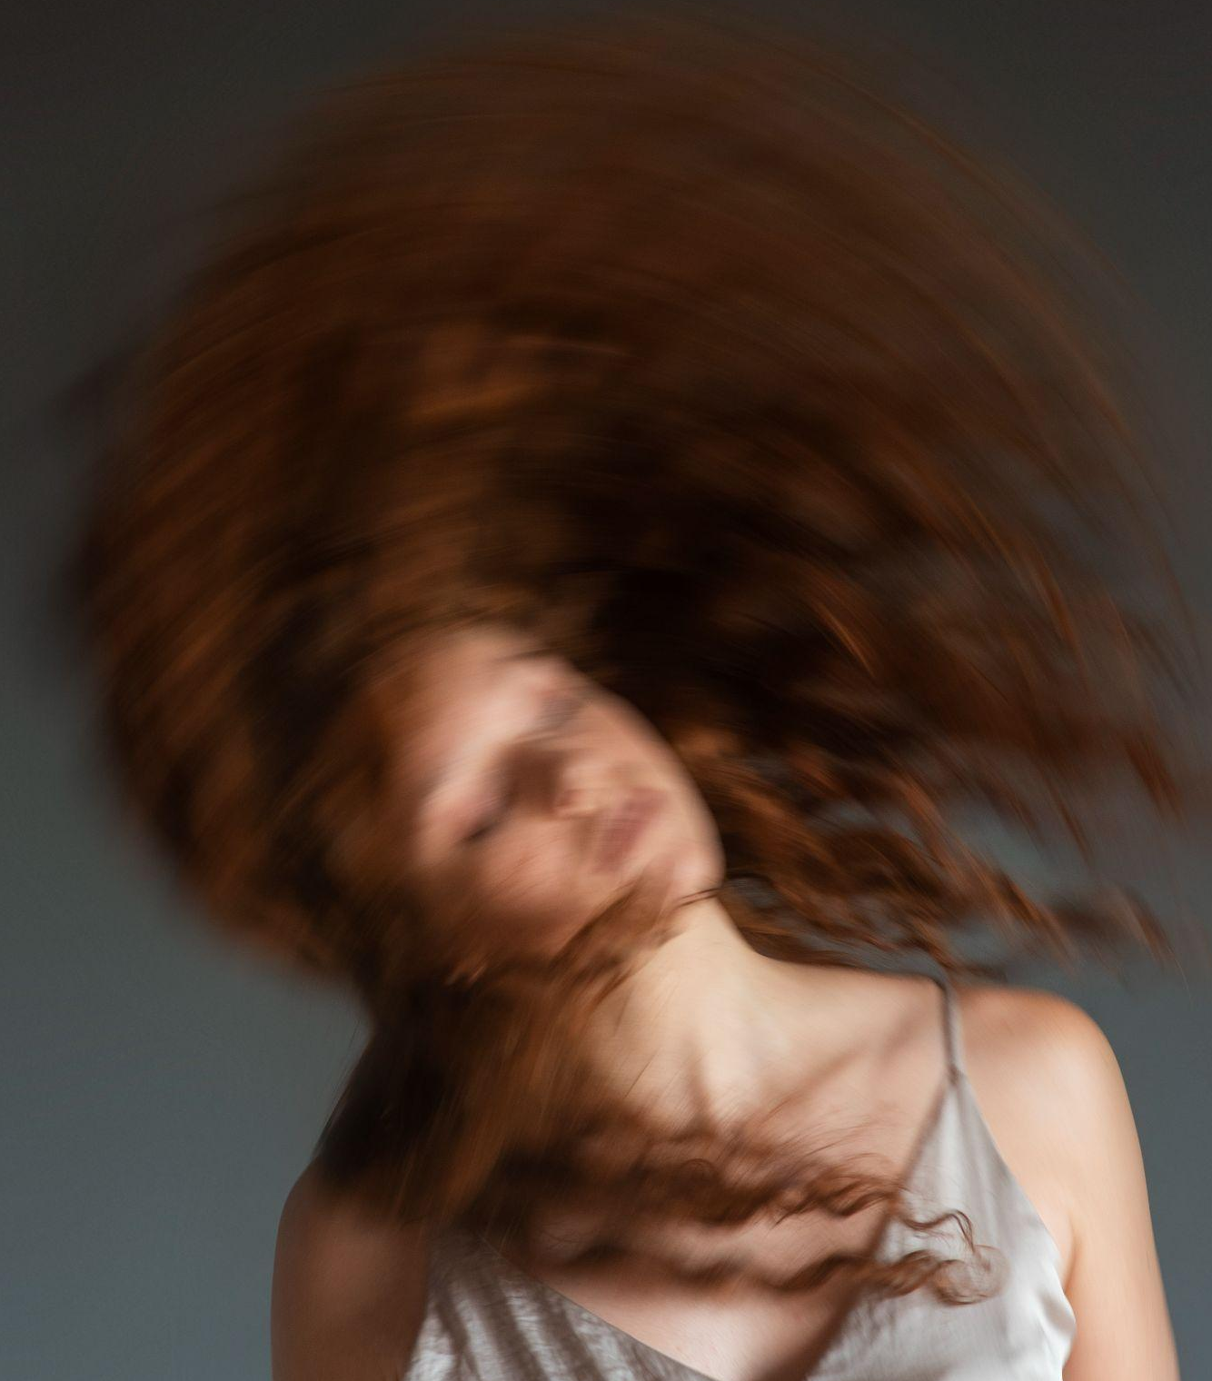
Embracing freedom and responsibility
Do you know what helps you make your point clear?
Lists like this one:
They’re simple
You can organize your ideas clearly
You’ll never forget to buy milk!
And the most important thing: the audience won’t miss the point of your presentation

Slide 20
Embracing mortality in existentialism
Type
of data
Mercury is the closest planet to the Sun and the smallest one in the Solar System it’s only a bit larger than the Moon
Mercury
Motives
Venus has a beautiful name and is the second planet from the Sun. It’s terribly hot even hotter than Mercury
Data
collection
Despite being red, Mars is actually a cold place. It’s full of iron oxide dust, which gives the planet its reddish cast
Specific
sampling
Jupiter is a gas giant and the biggest planet in the Solar System. It’s also the fourth-brightest object in the night sky

Slide 21
Navigating existential angst
Mercury
Venus
Mars
Mercury is the closest planet to the Sun and the smallest of them all
Venus has a beautiful name and is the second planet from the Sun
Despite being red, Mars is actually a cold place. It’s full of iron oxide dust

Slide 22
Confronting existential dilemmas
Phase 01
Phase 02
Mercury is the closest planet to the Sun and the smallest one in the Solar System—it’s a bit larger than the Moon
Jupiter is a gas giant, the biggest planet in the Solar System and the fourth-brightest object in the night sky
Neptune is the farthest planet from the Sun. It's also the fourth-largest planet by diameter in the Solar System
Venus has a beautiful name and is the second planet from the Sun. It’s terribly hot—even hotter than Mercury
Saturn is a gas giant and has several rings. This planet is composed mostly of hydrogen and helium
Earth is the third planet from the Sun and the only one that harbors life in the Solar System. This is where we all live

Slide 23
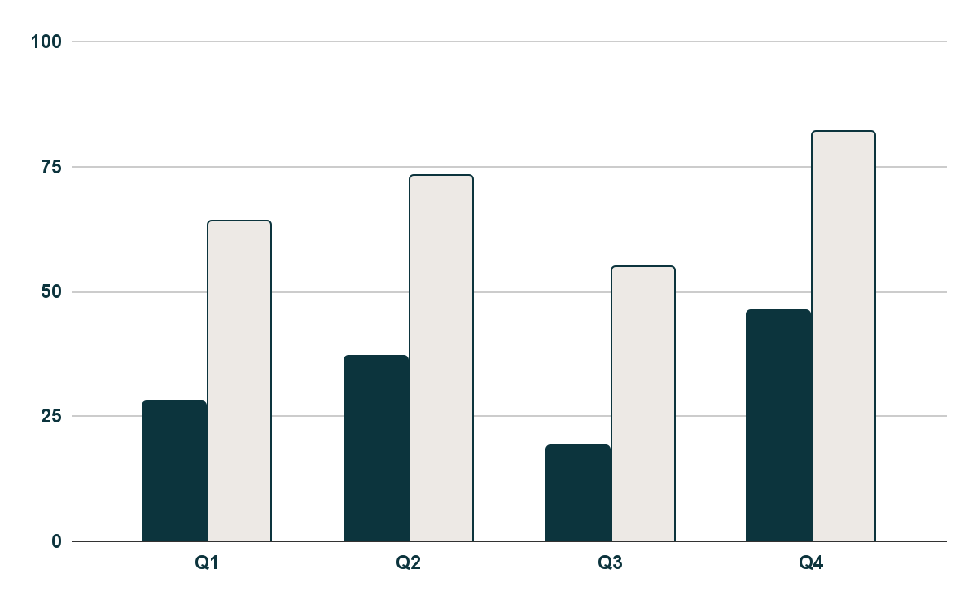
The heroic journey in existentialism
Mercury is the closest planet to the Sun and the smallest one in the Solar System The planet’s name has nothing to do with the liquid metal
The Sun is the star at the center of the Solar System
Jupiter is the biggest planet in the entire Solar System
Saturn is composed mostly of hydrogen and helium
Venus
Mercury
Venus has a beautiful name
Mercury is quite a small planet
Follow the link in the graph to modify its data and then paste the new one here. For more info, click here

Slide 24
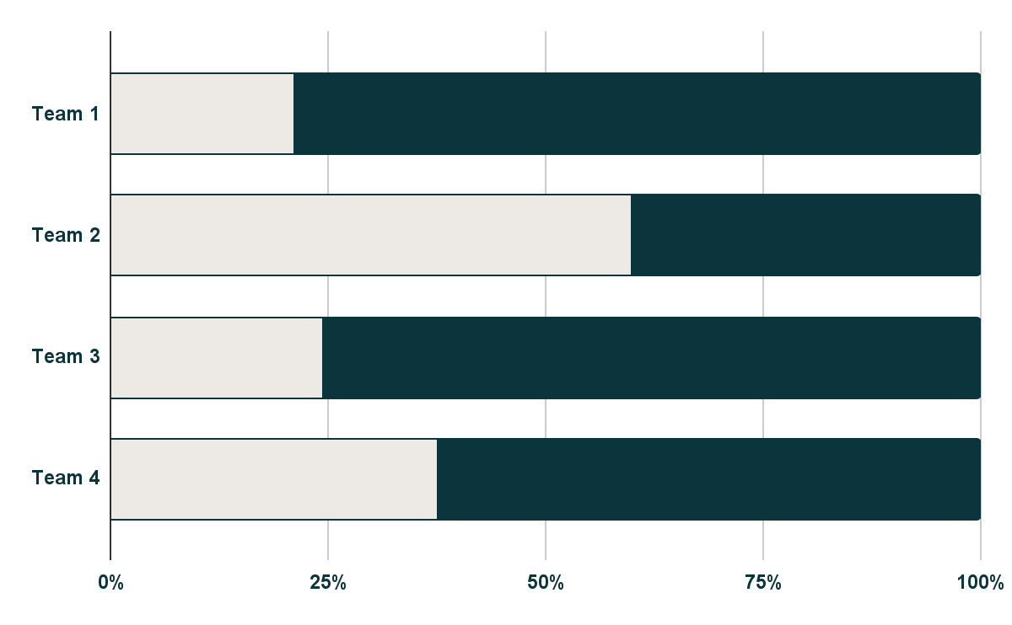
Battling existential despair
Venus
Mercury
Venus has a beautiful name
Mercury is quite a small planet
Mars
Despite being red, Mars is actually a cold place
55%
Follow the link in the graph to modify its data and then paste the new one here. For more info, click here

Slide 25
Forging personal identity
Mars
Venus
Mars is actually a
very cold place
Venus has extremely high temperatures
Saturn
Jupiter
Saturn is a gas giant with several rings
Jupiter is the biggest planet of them all

Slide 26
Embracing existentialism today
Mars & Earth
1
Discussion 1
Despite being red, Mars is actually a cold place. It's full of iron oxide dust, which gives the planet its reddish cast. Earth is the third planet from the Sun and the only one that harbors life in the Solar System. This is where we all live:
Ceres is located in the main asteroid belt
The Moon is Earth’s natural satellite
Neptune is very far away from us
Pluto is now considered a dwarf planet
Mercury is the closest planet to the Sun and the smallest one in the Solar System it’s only a bit larger than the Moon
Discussion 2
2
Venus has a beautiful name and is the second planet from the Sun. It’s terribly hot even hotter than Mercury

Slide 27
The willpower of the individual
Mars
Venus
Despite being red, Mars is actually a cold place. It’s full of iron oxide dust
Venus has a very beautiful name and is the second planet from the Sun
Mercury
Neptune
Mercury is the closest planet to the Sun and the smallest one in the Solar System
Neptune is the fourth-largest planet by diameter in the Solar System

Slide 28
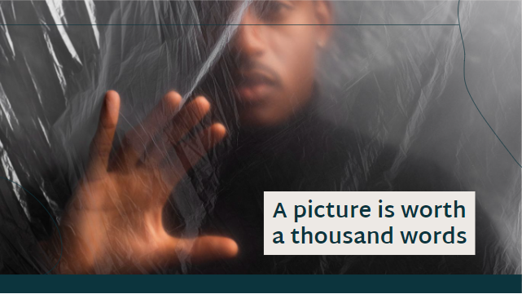
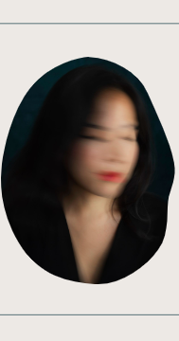
Mockups
You can replace the images on the screen with your own work. Just right-click on them and select “Replace image”

Slide 29
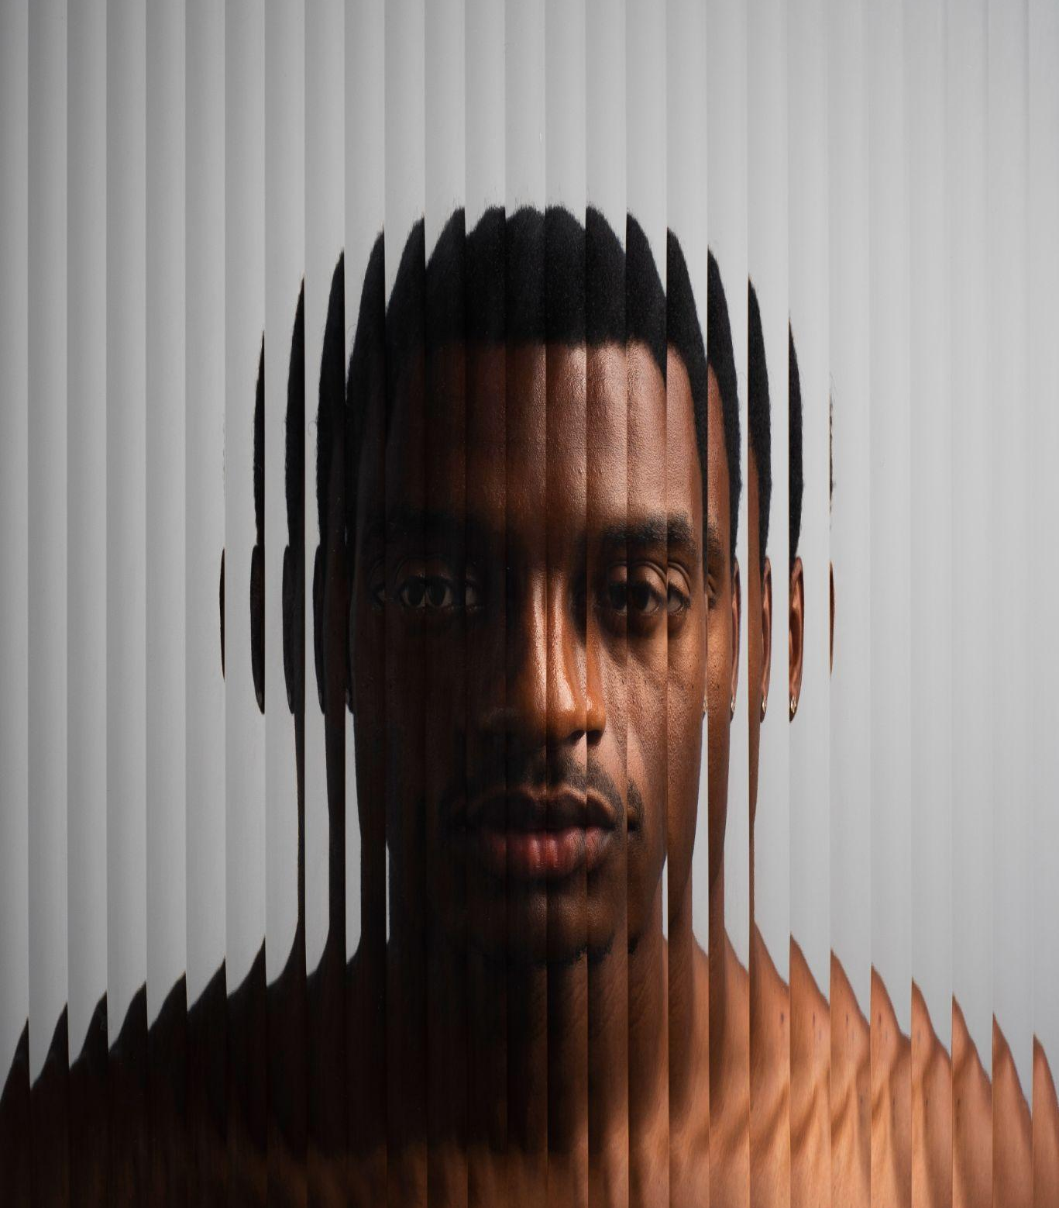
Bibliographical references
Surname, A. (YEAR). Name of the source. Publisher
Surname, A. (YEAR). Name of the source. Publisher
Surname, A. (YEAR). Name of the source. Publisher
Surname, A. (YEAR). Name of the source. Publisher
Surname, A. (YEAR). Name of the source. Publisher
Surname, A. (YEAR). Name of the source. Publisher
Surname, A. (YEAR). Name of the source. Publisher
Surname, A. (YEAR). Name of the source. Publisher
Surname, A. (YEAR). Name of the source. Publisher
Surname, A. (YEAR). Name of the source. Publisher

Slide 30
Thanks!
Do you have any questions?
youremail@freepik.com
+34 654 321 432
yourwebsite.com
Please keep this slide for attribution

Slide 31
Alternative resources
Here’s an assortment of alternative resources whose style fits that of this template:
Translucent and blurred portrait of man I
Translucent and blurred portrait of man II
Translucent and blurred portrait of man III
Translucent and blurred portrait of man IV
Translucent and blurred portrait of woman I
Translucent and blurred portrait of woman II
Translucent and blurred portrait of woman III
Translucent and blurred portrait of woman IV
Translucent and blurred portrait of woman V
Translucent and blurred portrait of woman VI

Slide 32
Resources
Did you like the resources on this template? Get them for free at our other websites:
Photos
Translucent and blurred portrait of woman I
Translucent and blurred portrait of man I
Translucent and blurred portrait of woman II
Translucent and blurred portrait of man II

Slide 33
Instructions for use
If you have a free account, in order to use this template, you must credit Slidesgo by keeping the Thanks slide. Please refer to the next slide to read the instructions for premium users.
As a Free user, you are allowed to:
Modify this template.
Use it for both personal and commercial projects.
You are not allowed to:
Sublicense, sell or rent any of Slidesgo Content (or a modified version of Slidesgo Content).
Distribute Slidesgo Content unless it has been expressly authorized by Slidesgo.
Include Slidesgo Content in an online or offline database or file.
Offer Slidesgo templates (or modified versions of Slidesgo templates) for download.
Acquire the copyright of Slidesgo Content.
For more information about editing slides, please read our FAQs or visit our blog:
https://slidesgo.com/faqs and https://slidesgo.com/slidesgo-school

Slide 34
Instructions for use (premium users)
As a Premium user, you can use this template without attributing Slidesgo or keeping the "Thanks" slide.
You are allowed to:
Modify this template.
Use it for both personal and commercial purposes.
Hide or delete the “Thanks” slide and the mention to Slidesgo in the credits.
Share this template in an editable format with people who are not part of your team.
You are not allowed to:
Sublicense, sell or rent this Slidesgo Template (or a modified version of this Slidesgo Template).
Distribute this Slidesgo Template (or a modified version of this Slidesgo Template) or include it in a database or in any other product or service that offers downloadable images, icons or presentations that may be subject to distribution or resale.
Use any of the elements that are part of this Slidesgo Template in an isolated and separated way from this Template.
Register any of the elements that are part of this template as a trademark or logo, or register it as a work in an intellectual property registry or similar.
For more information about editing slides, please read our FAQs or visit our blog:
https://slidesgo.com/faqs and https://slidesgo.com/slidesgo-school

Slide 35
Fonts & colors used
This presentation has been made using the following fonts:
Martel Sans
(https://fonts.google.com/specimen/Martel+Sans)
PT Sans
(https://fonts.google.com/specimen/PT+Sans)
#0c343d
#ede9e5ff

Slide 36





Storyset
Create your Story with our illustrated concepts. Choose the style you like the most, edit its colors, pick the background and layers you want to show and bring them to life with the animator panel! It will boost your presentation. Check out how it works.
Pana
Amico
Bro
Rafiki
Cuate

Slide 37
Use our editable graphic resources...
You can easily resize these resources without losing quality. To change the color, just ungroup the resource and click on the object you want to change. Then, click on the paint bucket and select the color you want. Group the resource again when you’re done. You can also look for more infographics on Slidesgo.

Slide 40
JANUARY
FEBRUARY
MARCH
APRIL
MAY
JUNE
PHASE 1
Task 1
Task 2
PHASE 2
Task 1
Task 2
JANUARY
FEBRUARY
MARCH
APRIL
PHASE 1
Task 1
Task 2

Slide 43
...and our sets of editable icons
You can resize these icons without losing quality.
You can change the stroke and fill color; just select the icon and click on the paint bucket/pen.
In Google Slides, you can also use Flaticon’s extension, allowing you to customize and add even more icons.

Slide 44
Educational Icons
Medical Icons

Slide 45
Business Icons
Teamwork Icons

Slide 46
Help & Support Icons
Avatar Icons

Slide 47
Creative Process Icons
Performing Arts Icons

Slide 48
Nature Icons

Slide 49
SEO & Marketing Icons

Slide 50


